Slide 2

Agenda
BOP Overview
BOP Eligible Risks
Types of Liability
What is covered under BOP
Premium Criteria
Valuation Method
Policy issuance life cycle

Slide 3

Business Owners Program
Business Owners Program is designed to provide Insurance protection for Small business owners and proprietors
BOP Program provides Property, Loss of Income and Liability coverage for Small Business Owners
A Business owners policy provides coverage for all eligible buildings and business personal property owned by an insured and for all of the insured’s eligible business liability exposures
3
Notes:
The Business owners Policy (BOP) is designed for small to medium size businesses. BOP policies are structured and priced to fill the need of a multitude of businesses which have similar risk characteristics. The basic concept is that small businesses of all kinds have more in common with each other than they do with large risks in the same kind of business.
BOP policies may be written for eligible retail, apartment, office, service, and processing risks and are available for owners of buildings and tenants of retail, service, and processing operations. In addition to the type of business for which coverage is being sought, the building height, area square footage, number of units and annual gross sales are determining factors for acceptability under the BOP program

Slide 4


Business Owners Program
BOP Program contains two forms:
Standard Form that provides property coverage on a named peril basis
Special Form that provides property coverage against all physical risks of loss with designated
exclusions
Both forms include Commercial Liability coverage
4
Notes:
The standard form includes Building coverage and Business Personal Property on a replacement cost basis, with an ACV (actual cash value) option for building coverage. Business Income and Extra Expense coverage is included on an “Actual Loss Sustained” basis. Perils covered are fire, lightning, explosion, windstorm or hail, smoke, aircraft or vehicles, riot or civil commotion, vandalism, sprinkler leakage, sinkhole collapse, volcanic action, and transportation. In addition, the liability portion of the policy includes protection for business liability and medical expenses.

Slide 5

BOP – Risk Eligibility
BOP Program is limited to the following small and simple risks with similar exposure
Apartments
Condominiums
Offices
Small retail, service and processing risks
Restaurants
Warehouses
Wholesale operations
5

Slide 6

Risk Eligibility Criteria – BOP – An Example
Each of the risks have specific eligibility criteria to be offered protection under BOP:
Example: For Restaurants to be covered under BOP
Total area of restaurant not to exceed 7,500 s ft
Sale of alcoholic beverages not to exceed 25% of total sales
Seasonal operations can not be closed for more than 30 consecutive days
Annual gross sales not to exceed $1 million at any Insured location
6
Notes:
The following requirements must be met in order for processing, servicing, and retail risks to be eligible for coverage under the BOP Policy:
(1) No more than 25% of gross sales may be from off-premises operations. (2) The risk cannot occupy more than 15,000 square feet in total area, and (3) The annual gross sales per location do not exceed $3 million.

Slide 7
Types of Liability
Types of Business Liability Insurance
General Liability Insurance: Talking about this form of business liability insurance it can be termed as the main coverage to protect your business from: injury claims, property damages, and advertising claims. General liability insurance also known as Commercial General Liability (CGL) in some parlance may be the only type of business liability insurance you need depending on your business situation.
Professional Liability Insurance: Business owners providing services will certainly require taking into perspective having professional liability insurance known as errors and omissions. This sort of coverage protects your business against malpractice, errors, negligence and omissions. On the basis of your profession, it may be a legal requirement to carry such a policy. Doctors need coverage to practice in certain states. On the other hand technology consultants often need coverage in independent contractor work arrangements.
Product Liability Insurance: Small businesses selling or in other word manufacturing products should be protected in the event of a person becoming injured as a result of using the product. Furthermore the amount of coverage and the level of risk depend on your business type. Whereas a retailer of scrap book supplies will have far less risks than a wood stove builder.
7

Slide 8

Business Owners Principal Coverages
Buildings Coverage
Business Personal Property Coverage
Loss Of Income Coverage
Bodily Injury and Property Damage Liability Coverage
Medical Payments Coverage
Products and Completed Work Coverage
Fire Legal Liability Coverage
Personal and Advertising Injury Liability Coverage
8
Notes:
Building – Includes coverage for the building, completed additions, permanently installed fixtures, machinery, and equipment, outdoor fixtures and furniture, floor coverings, and other similar property typically used to maintain the building.
Business Personal Property – Covers business personal property (as defined in the policy) in or on the building or in the open within 100 feet of the described premises.
Personal Property of Others – Covers personal property of others in the care, custody, and control of the insured within the described premises or within 100 feet of the described premises.
Business Liability – Includes coverage for bodily injury, property damage, personal injury and/or advertising injury. Coverage applies only to those premises and operations designated in the Declarations.
Medical Expenses – Covers medical expenses for bodily injury caused by a covered loss
Business Income – Coverage for the actual loss of business income sustained due to the necessary suspension of operations caused by a covered property loss during the period of restoration, as defined by the policy.

Slide 9

Business Owners Limits
Property Damage Limits: Building is covered under either of any valuation method
Full replacement value of the insured buildings
Full replacement value of the insured business personal property
20% of Coverage A limit + 100% of Coverage B limit
9
Notes:
BOP typically provides the following two major types of coverage for your business:
These are the names given by ISOS / ASIS
Coverage A (buildings): This coverage includes the buildings and structures described in the declarations section. Among other things, this coverage also protects completed additions, indoor and outdoor fixtures, personal property furnished by you as landlord, and personal property used for service or maintenance of the buildings or premises. It may also include additions under construction and costs associated with building alterations or repairs. You don't need this coverage if you're a tenant in someone else's building.
Coverage B (business personal property): This coverage includes property owned by you and used in your business operations. Your property is generally covered if it's in or on the described buildings, or within 100 feet of your business premises while in a vehicle or out in the open. You're also covered for the property of others while it's in your care, custody, or control (up to your legal liability, plus the costs of your labor, materials, and services).
A standard deductible is often $250 per loss, though higher amounts may be available and will usually lower your premium.

Slide 10
Liability Limits
500,000/10,00,000
2X
Per Occurrence
Policy Aggregate
Single Occurrence Limit – This is the limit the insurer will pay on one occurrence
Aggregate Limit – This is the maximum amount the insurer will pay during any policy period for all of the occurrences in the policy period. Generally, this is two times the single occurrence limit
10
Notes:
General liability is also covered within a BOP up to $1,000,000 per occurrence. Some insurers will allow you to lower your occurrence level coverage to $500,000 or increase it to $2,000,000. They will also give you an aggregate level of coverage that may increase your total coverage for the year to include multiple occurrences. Often the aggregate limit is twice the maximum occurrence limit. A simple way to understand the difference between aggregate limits and occurrence limits is that for each claim you are limited to your occurrence limit, however, you can have as many claims during your policy as your aggregate can handle.
Keep in mind that your aggregate limit is your total amount of insurance for the policy period. You will want this number to be a realistic reflection of your company's exposure to risk.

Slide 11
Premium Criteria
The premium of the Business Owner's Insurance Policy may vary according to the insurance company, but the premiums are based on some common factors that include all the criteria mentioned below –
Size of the Business Premises
Type of Business
Extent of Offsite Activity
Required Limits of Liability
Additionally, the following factors are also considered for determining the BOP premiums:
Business Locations
Financial Stability
Security Features
Building Construction
Risk of Fire
11

Slide 12
Premium Criteria – Class Codes
DESC | Code | Classification | Entprrise Code (Enum)
AC and Heating Distributor/Wholesaler | ACHeatingDistrWholesaler | Wholesale | 8465
AC and Heating Equipment/Supplies Retail | ACHeatingEquipSupplyRtl | Mercantile | 8466
Accounting & Auditing Office | AccountingAuditingOffice | Office | 8467
Advertising Office | AdvertisingOffice | Office | 8468
Animal Hospital Office | AnimalHospitalOffice | Office | 8469
Appliances - Sales and Service Retail | ApplianceSalesSvcRetail | Mercantile | 8470
Appliances-Household-Sales & Service Wholesale | ApplianceHshldSalesSvcWsl | Wholesale | 8471
Appraiser Office | AppraiserOffice | Office | 8472
Architect Office | ArchitectOffice | Office | 8473
Arts & Craft Store Retail | ArtsCraftsStoreRetail | Mercantile | 8474
Arts & Craft Store Wholesale | ArtsCraftsStoreWholesale | Wholesale | 8475
Attorney | Attorney | Office | 8476
Automotive Parts & Accessories Retail | AutoPartsAccessRetail | Mercantile | 8477
Automotive Parts & Accessories Wholesale | AutoPartsAccessWholesale | Wholesale | 8478
Bakery-No Comml Cooking on Premises Retail | BakryWOCommlCookOnPremRtl | Mercantile | 8479
Bakery-No Comml Cooking on Premises Whsle | BakryWOCommlCookOnPremWsl | Wholesale | 8480
Balloons Retail | BalloonsRetail | Mercantile | 8481
Balloons Wholesale | BalloonsWholesale | Wholesale | 8482
Barber & Beauty Supplies Retail only | BarberBeautySupplyRetail | Mercantile | 8483
Barber Shop | BarberShop | Service | 8484
Baseball Cards, Stamps/Other Collectibles Retail | BasballCardStampsCllctRtl | Mercantile | 8485
Baskets Retail | BasketsRetail | Mercantile | 8486
Baskets Wholesale | BasketsWholesale | Wholesale | 8487
Beauty Shop | BeautyShop | Service | 8488
12
Notes:
Various class of operations and Class codes are used for premium calculation. This can be seen from the above list.
The risk is classified in various groups as listed above, these risk are then subject to various rates which determine the premium.

Slide 13
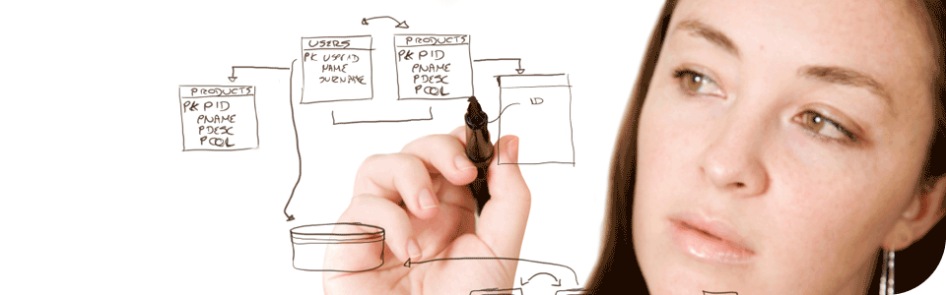
Business Owners Policy Term
Policies can be written
for a term of one year and renewed annually
or
on a continuous basis
13

Slide 14

Valuation Methods
ACV
Replacement Cost
Extended Value Replacement Cost
Functional Value
14
Notes:
Replacement cost" is defined or explained in the policy. Simply stated, it means the cost to replace the property on the same premises with other property of comparable material and quality used for the same purpose. This applies unless the limit of insurance or the cost actually spent to repair or replace the damaged property is less.
The only difference between replacement cost and actual cash value is a deduction for depreciation. However, both are based on the cost today to replace the damaged property with new property.
Functional value - A property insurance provision changing the valuation basis otherwise applicable (actual cash value or replacement cost value) to valuation at the cost to replace the damaged or destroyed property with property that serves the same function. Used when replacement of damaged property with substantially identical property is either impossible (perhaps due to technological change) or unnecessary.
“Actual cash value" is not as easily defined. Some courts have interpreted the term to mean "fair market value," which is the amount a buyer would pay a seller if neither were under undue time constraints. Most courts, however, have upheld the insurance industry's traditional definition: the cost to replace with new property of like kind and quality, less depreciation
Extended Value Replacement Cost
Pays a certain amount above the policy limit to replace a damaged home, generally 120 percent or 125 percent. Similar to a guaranteed replacement cost policy, which has no percentage limits. Most homeowner policy limits track inflation in building costs. Guaranteed and extended replacement cost policies are designed to protect the policyholder after a major disaster when the high demand for building contractors and materials can push up the normal cost of reconstruction.

Slide 15
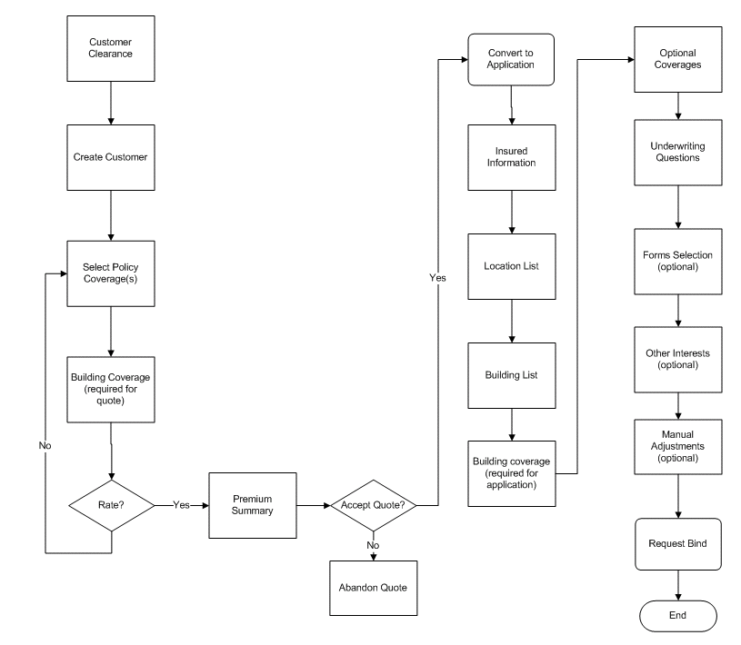
Policy issuance Process
15

Slide 16

EXPERIENCE
EXPERTISE
R&D
APPROACH (KEEP-CUSTOMER-FOR-LIFE approach)
Thank you. Hope the presentation has been of value to you.

